Slide 1

Angular

Slide 2


What is Angular
Angular is a popular JavaScript framework
developed by google.

Slide 3

Why Angular popular?
Component based architecture
Routing
Data Binding
Dependency Injection

Slide 4
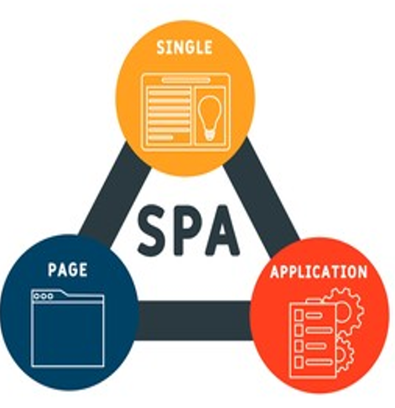
SPA refers to Single page application
.
Dynamically updates a single HTML page
than reloading entire
pages or navigating to different pages
Faster UI more interactive.
The most notable difference between
a regular website and an SPA is the
reduced amount of page refreshes

Slide 5


Angular CLI
Angular CLI (Command Line Interface) is a command-line tool that makes it easy to create, develop, and maintain Angular applications.
It provides a set of useful commands and tools to create test and deploy angular applications quickly.
Angular CLI is built on top of Node.js and uses the npm package manager to manage dependencies.

Slide 6

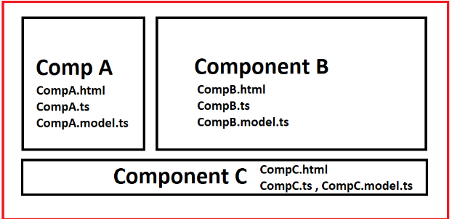
COMPONENTS
Components are the most basic UI building block of an Angular app. An Angular app contains a tree of Angular components.

Slide 7

Module
A module in Angular is a container for a set of related components, directives, pipes, and services, and it helps to organize and encapsulate different parts of an application.

Slide 8
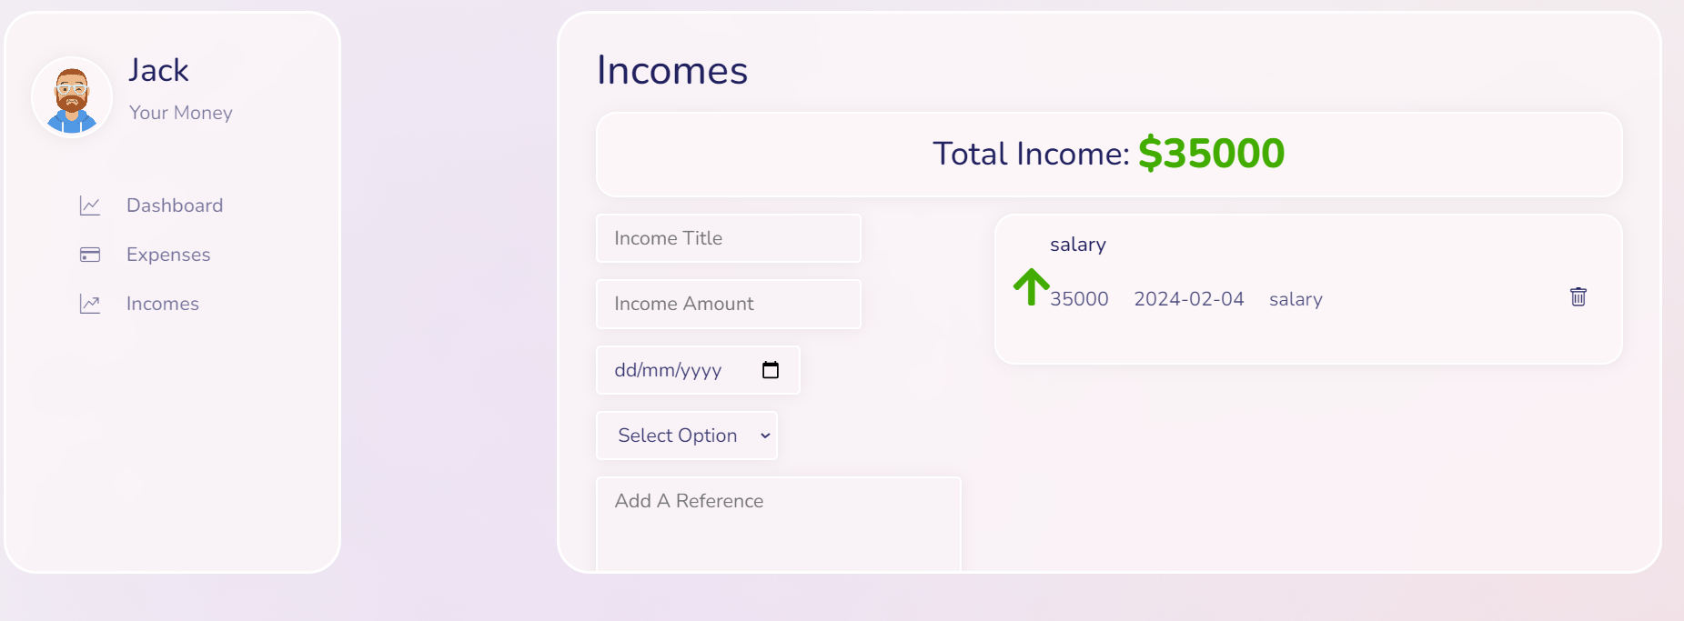
component1
component2

Slide 9
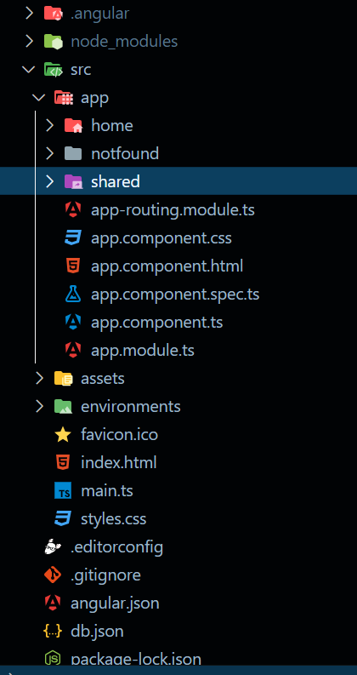
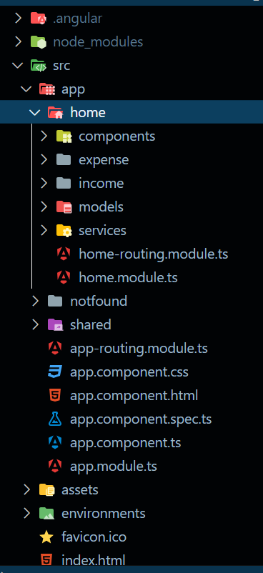
Project structure
Module creation

Slide 10
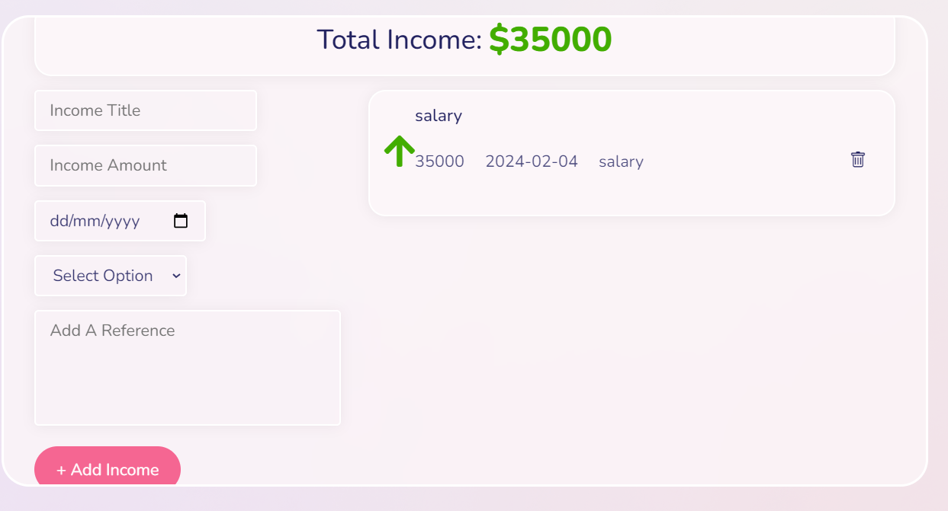
Data Binding
Data binding
Angular data binding is a two-way process: it can both send and receive data

Slide 11
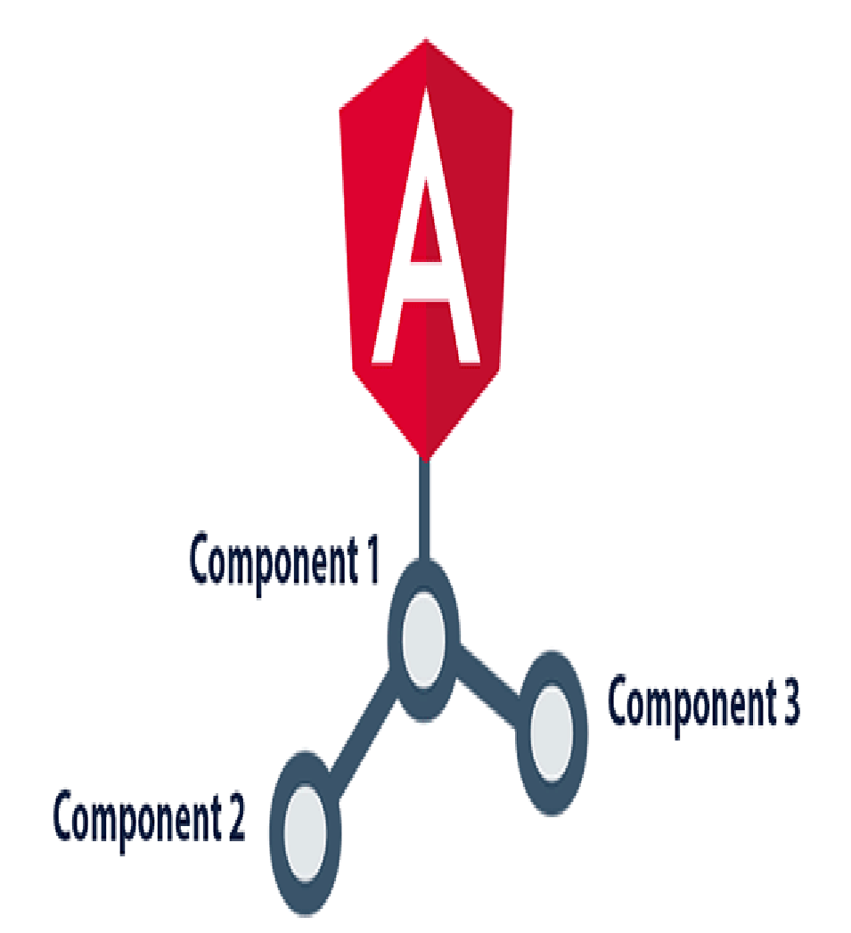
Routing
Sidebar Component
Navbar Component
dashboard
App Component
Income Component
Expense
Component

Slide 12

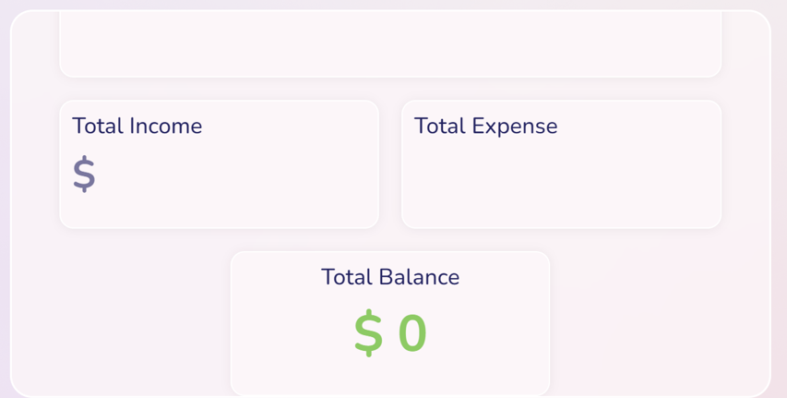
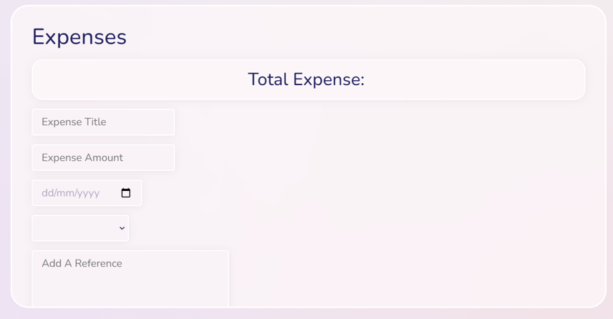
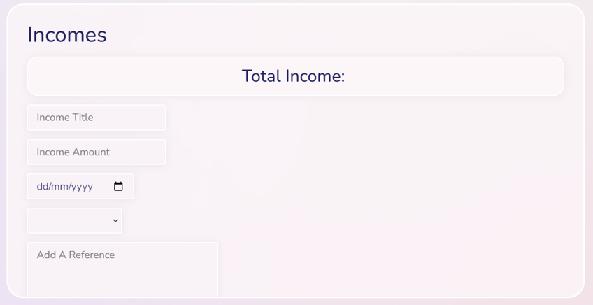

Slide 13

Angular Forms
Angular forms are a key feature that allows users to interact with web applications by inputting data.
They handle user input, provide validation to ensure data accuracy, and offer error messages for incorrect entries.
Forms maintain their state, making it easy to track user actions, and can be created using either template-driven or reactive approaches for flexibility and ease of use.

Slide 14

Introduction To Reactive forms
Reactive forms in Angular provide a programmatic and flexible approach to form creation and management.
Unlike template-driven forms, they are defined in TypeScript classes, allowing fine-grained control over form elements and validation rules.
Reactive forms use observables from RxJS to handle form state changes and asynchronous operations efficiently, making them ideal for complex forms with dynamic behaviour and advanced validation needs.

Slide 15
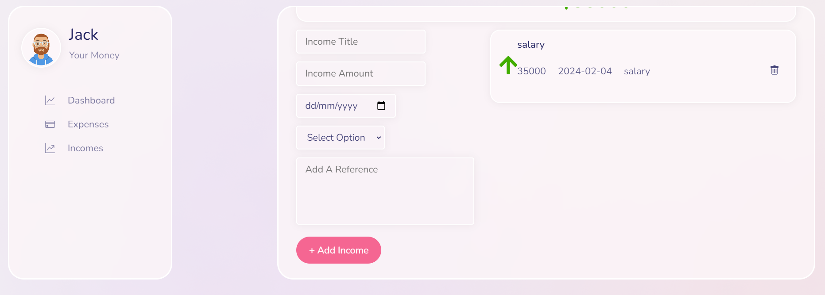
Reactive form

Slide 16
Services in Angular
Service is the act of providing assistance or fulfilling a need for someone or something.
It involves delivering a specific task, support, or solution to meet the requirements of others.
Services are intangible and can encompass a wide range of activities, from customer support to professional expertise.
The goal of service is to enhance the well-being or satisfaction of individuals or organizations.

Slide 17
Thanks!!

